Slide 1
Statistical Machine: Learning, Forecasting, and Inferences from Pandemic Data

Slide 2
👏 My heartfelt sincere gratitude for the frontline workers.

Slide 3
1. Coronaviruses is a large family of viruses which causes health disorders in animals and humans. 2. Several viruses of same family are popular for causing respiratory infections ranging from common cold to severe case of Middle East Respiratory Syndrome (MERS) and Severe Acute Respiratory Syndrome (SARS) and the most recent causes corona virus disease COVID19. 3. The first case of corona virus was reported in December 2019; in the Wuhan city of Hubei province of China, in East Asia & the world’s most populous country. 4. After which there has been a chain reaction contributary to the reporting of spread of infection globally in USA, South Korea, India, Italy, Spain, UK, Russia, Brazil and many more. 5. People get infection from COVID19, it spread rapidly from others through direct or indirect contact or through small droplets from nose or mouth when an infected person coughs, speaks or sneezes. 6. Normally it takes 4 to 5 days for the symptoms to show up post contamination. Common symptoms in relevance to the diagnosis would include fever, tiredness, dry cough, pain, nasal congestion, and development of difficulty in breathing. 7. Considering the seriousness of the situation the World Health Organization (WHO) declared it a pandemic on 11th March 2020 imposing a global emergency, over the outbreak of the disease, spread over a wide geographical area, affecting an exceptionally high proportion of global population.

Slide 4
8. In India the first case was reported on 30th January in Kerala. 9. Due to the exponential rise of cases in India, Govt. of India declared a nation-wide lockdown on 22nd March and named it as Janta Curfew. Which was later extended for next 21 days with the motive to increase physical distancing between people and to gain a control over the spread of infection. 10. Few healthcare personals and thinkers describe this incidence as the greatest humanitarian crisis post world war II. 11. The government’s around the world are working globally to contain the pandemic, but the Indian Government has been appreciated globally for its mature decisions, implementing a proactive nationwide lockdown, with the goal to reduce the number of infected people compared to the available healthcare facilities at disposal. Despite being one of the most densely populous country on the globe.

Slide 5
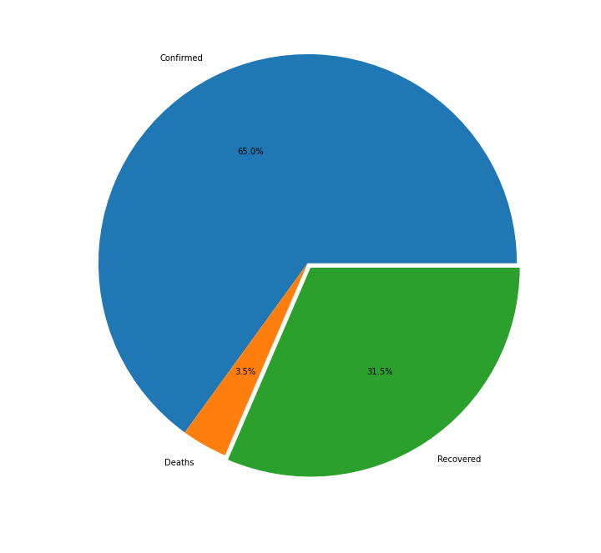
World Update
As of 16th June 2020, from total cases reported
Approximately, 65% cases are still under observation and in intensive care and isolation. While 3.5% cases have resulted in demise of people consisting of all age groups. While 31.5%, i.e. near one-third of the total have been able to successfully recover from the infection.

Slide 6
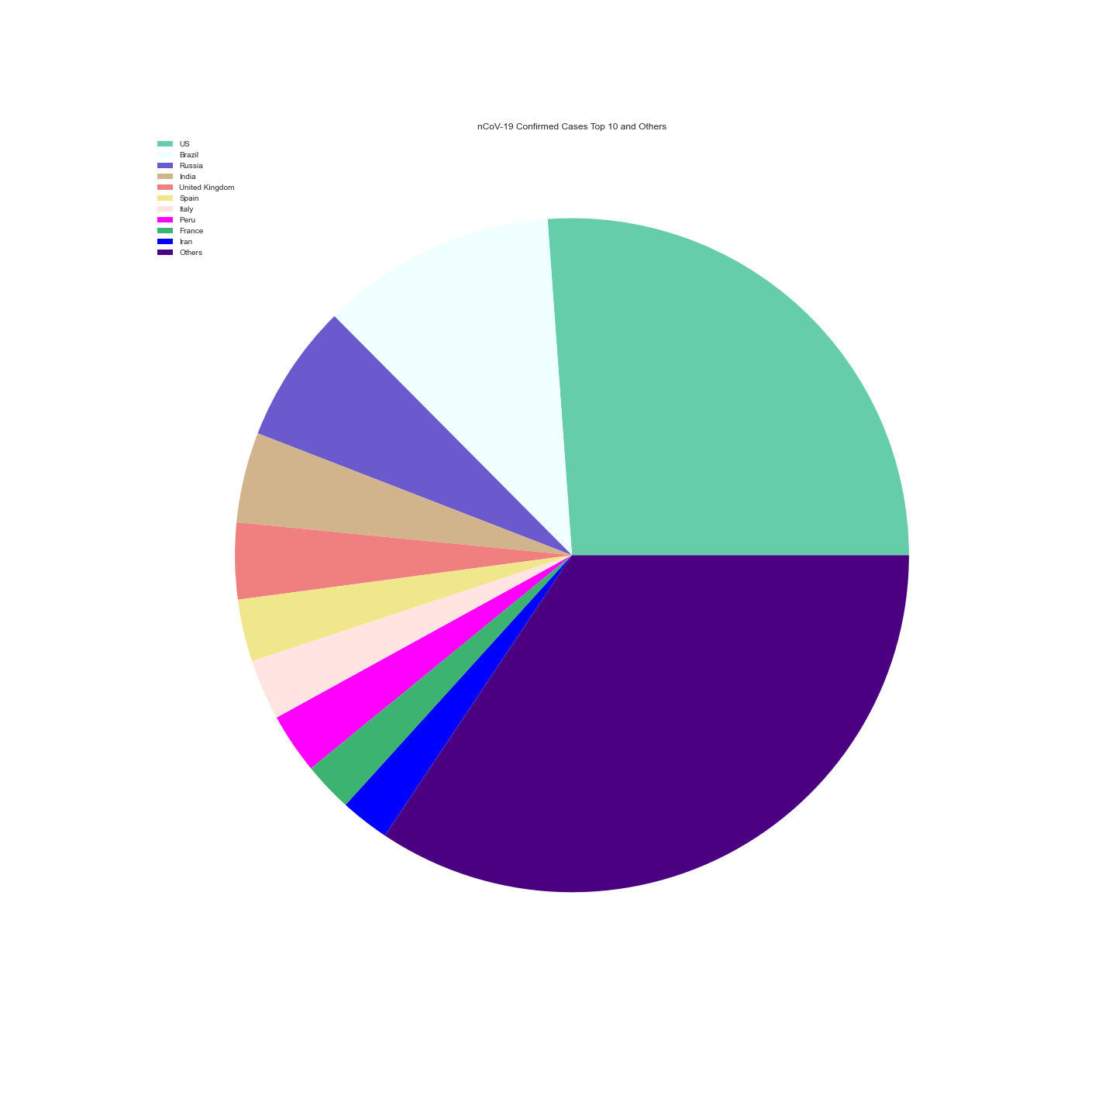
Global Contribution of countries in positive tested nCoV-19 population
The adjoining figure represents the contribution to the global population affected from nCoV-19.
While rest other countries are attributed as Others in pie chart.
From which we can classify or rank them based on their contribution to the global infected nCoV-19 population.
Others > US > Brazil > Russia > India > UK > Spain > Italy > Peru > France > Iran
The interesting fact around here is Russia and Brazil were no where near top 10 most impacted countries from coronavirus.
But within a month they have gained an exponential growth.

Slide 7
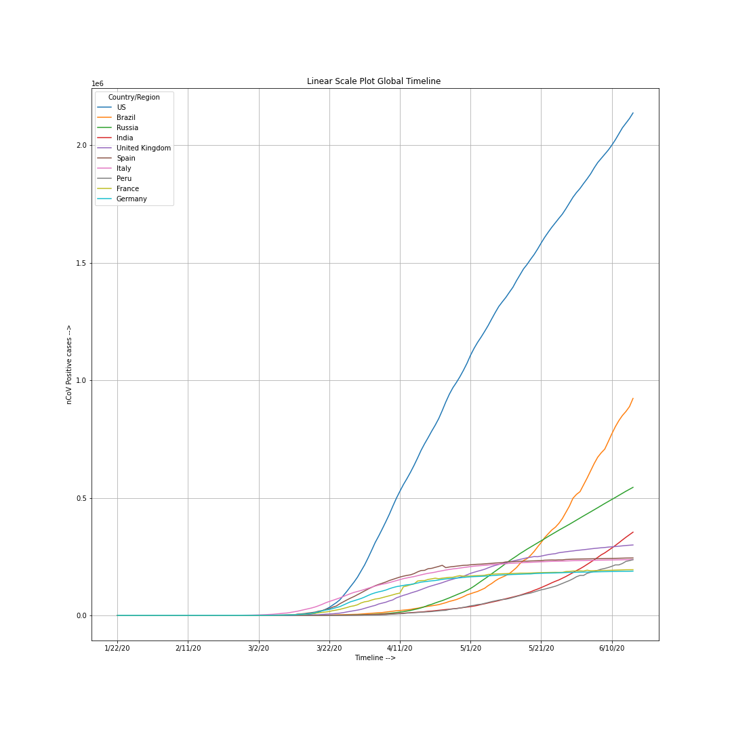
Where spread rate is concerned, it’s evident from the graph derived from the data, that US health system has failed in implementing ground level policies for avoid and preventing the spread of infection.
Whereas the hotspot countries remain to include
U.S.A. > Brazil > Russia > India > UK > Spain > Italy
> Peru > France > Germany
(order deduced from the graph)
On the contrary, China been in a stable state and is gradually declining, indicating a successful implementation of policies at grass root level.
Though being densely populated, the relative cases in India are low compared to others, can be because of two reasons
Lockdown imposed by PM Narender Modi
Low testing rate

Slide 8
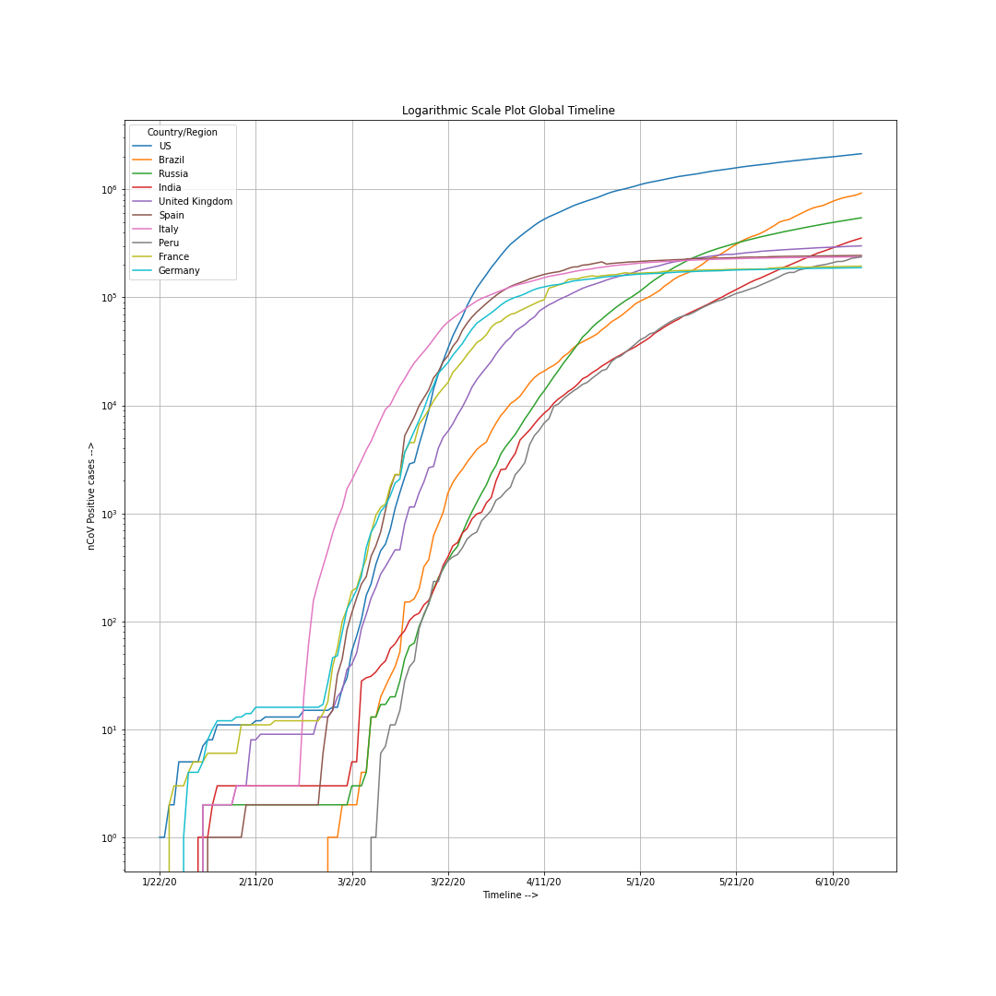
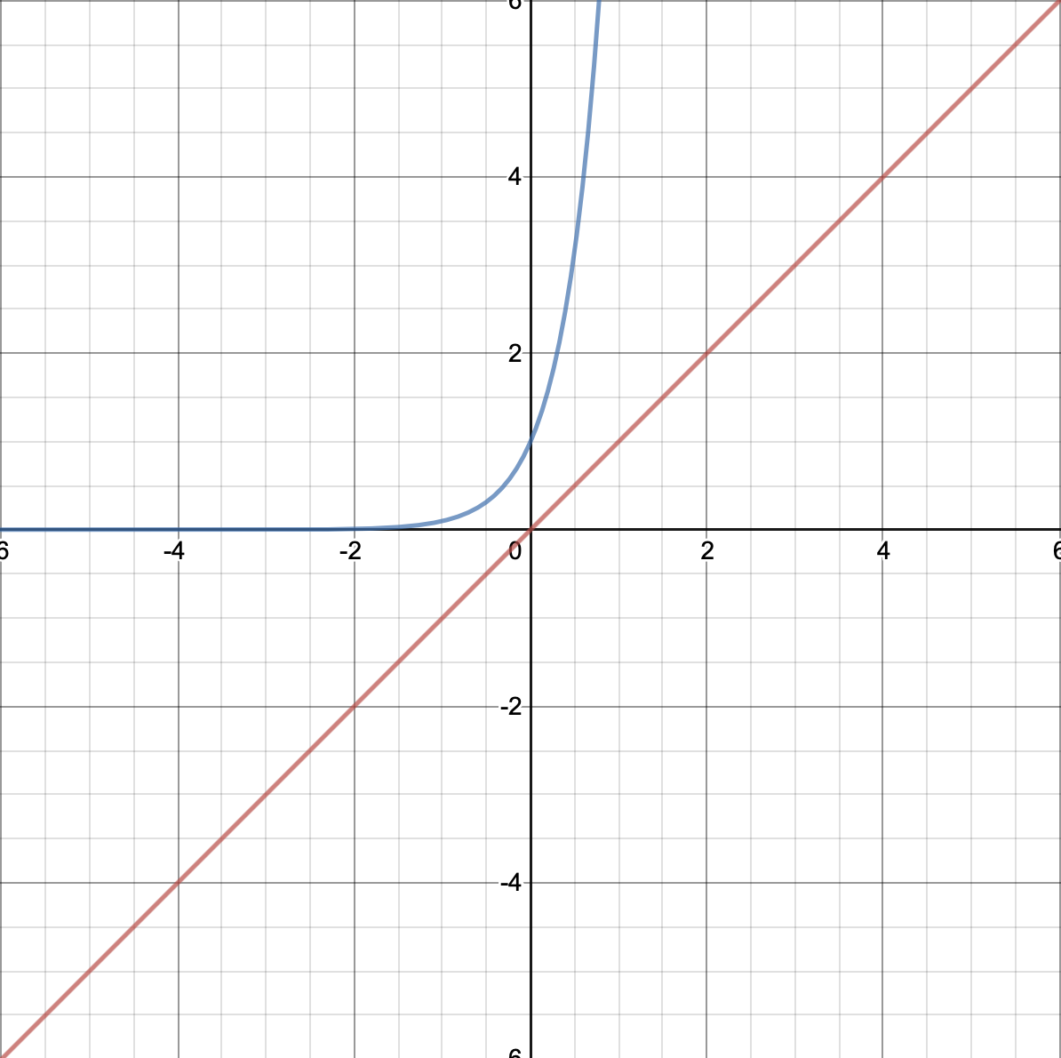
Linear Scale Graphical Plotting vs Exponential Graphical Plotting
The Graph to the left indicated positive nCoV-19 cases on exponential scale of 10.
Reason and intention to do so ?
Exponential Amplification

Slide 9
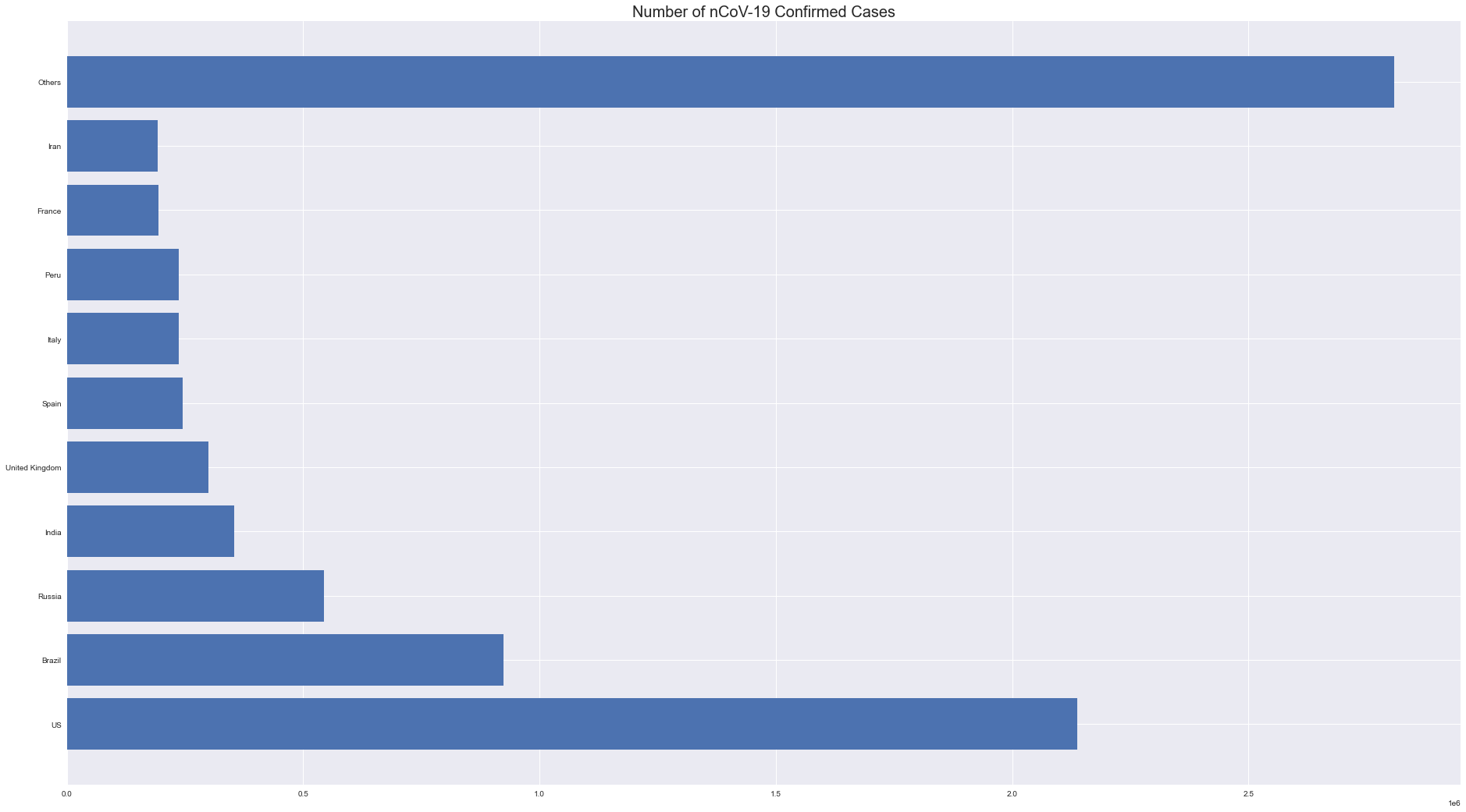
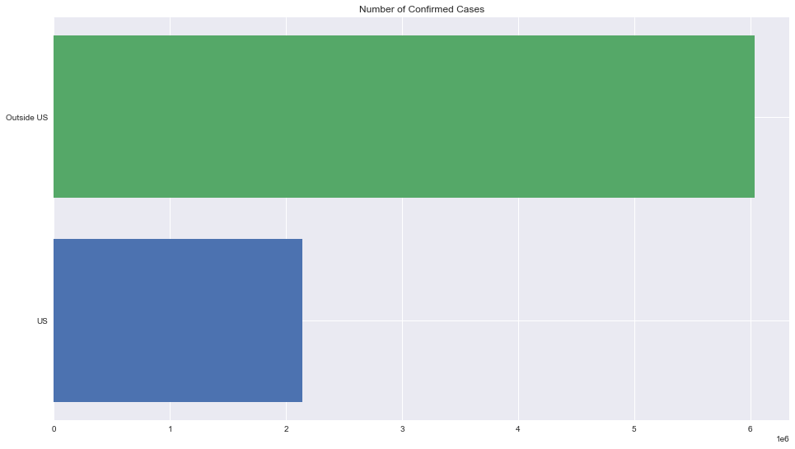
Comparison of US to other countries
Comparison of Top 10 countries to other residual countries

Slide 10
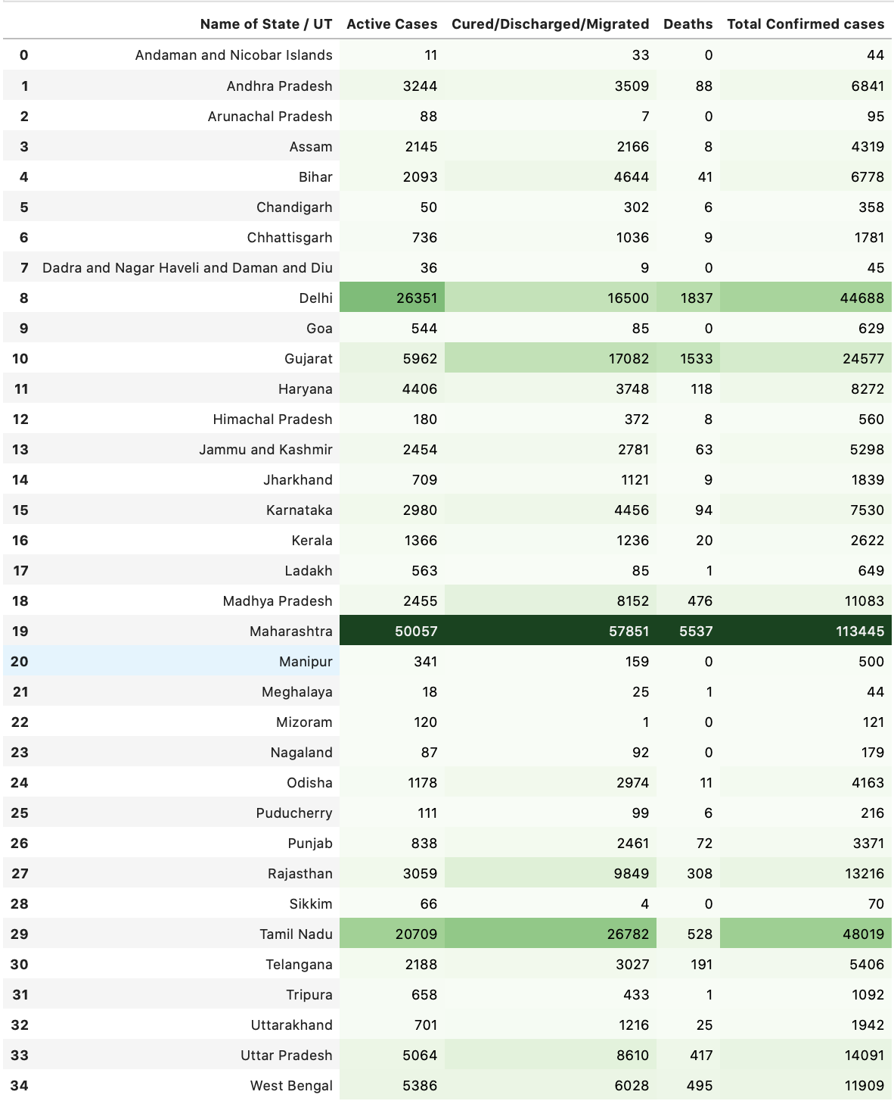
State wise Insights @ India

Slide 11
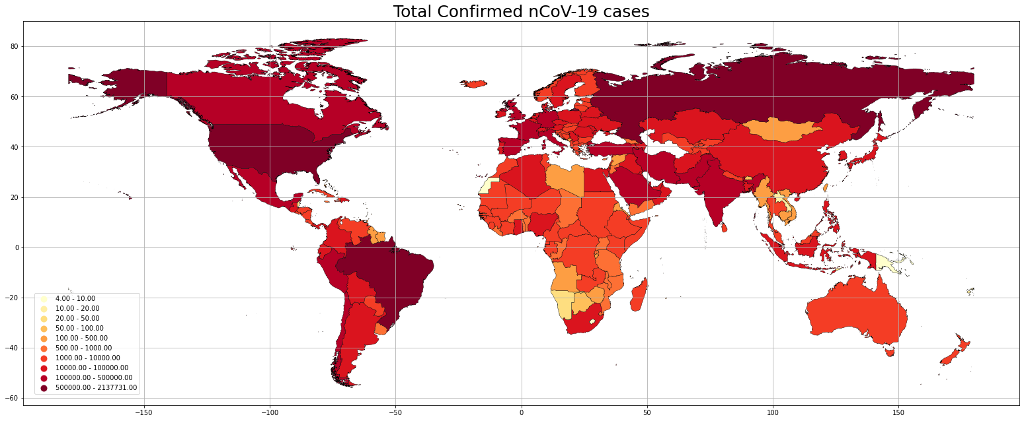
Choropleth Map 16th June 2020

Slide 12
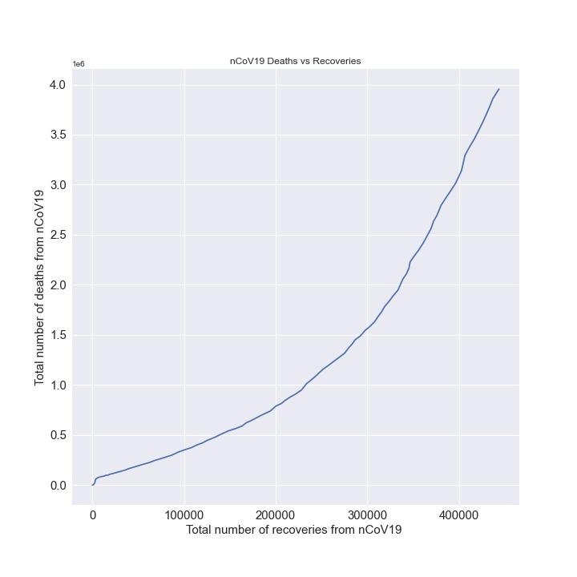
Total deaths vs Recoveries Graph (Linear Scale)
Significance of the graph ?
Implying increment in death rate compared to recovery rate, from the graphical pattern

Slide 13
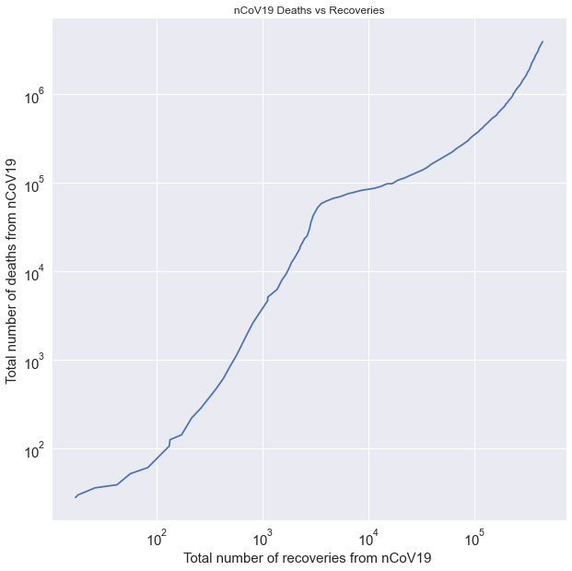
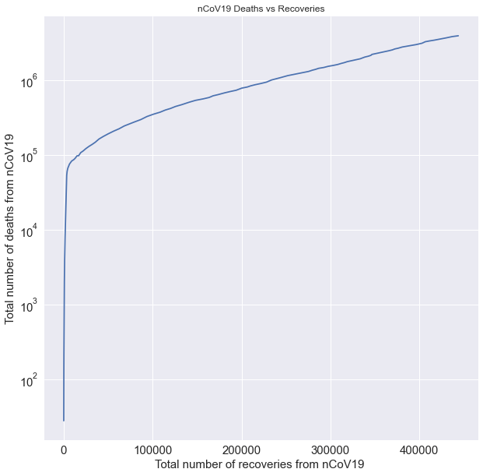
Total deaths vs Recoveries Graph (Both x and y-axis on exponential scale )
But interestingly if we retain original x axis and shift the y-axis in exponential frame, the graph resemble more to a sigmoid trying to reach saturation. Depicted below.

Slide 14
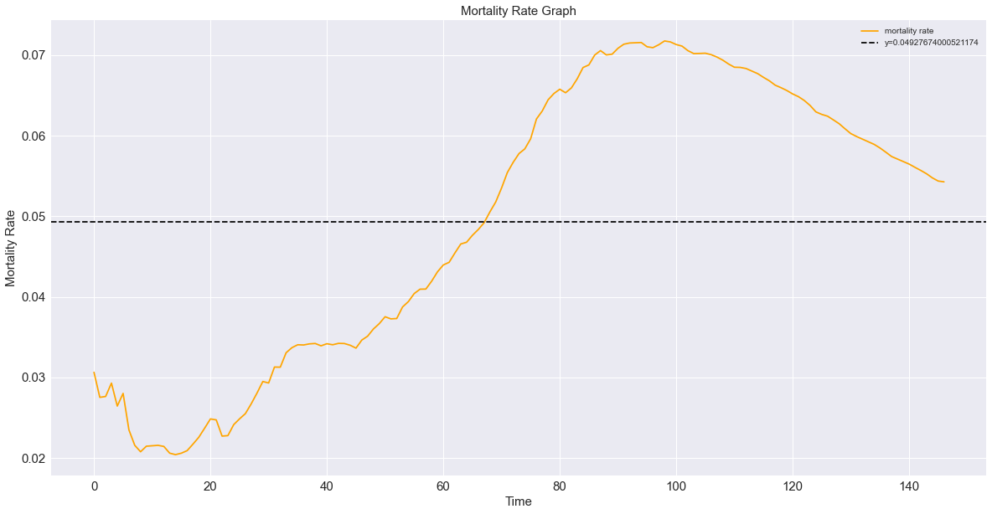
Mortality Rate = Total Deaths / Total Confirmed Cases (in Yellow)
and the mean morality rate 0.049 (Horizontal Black Line)

Slide 15
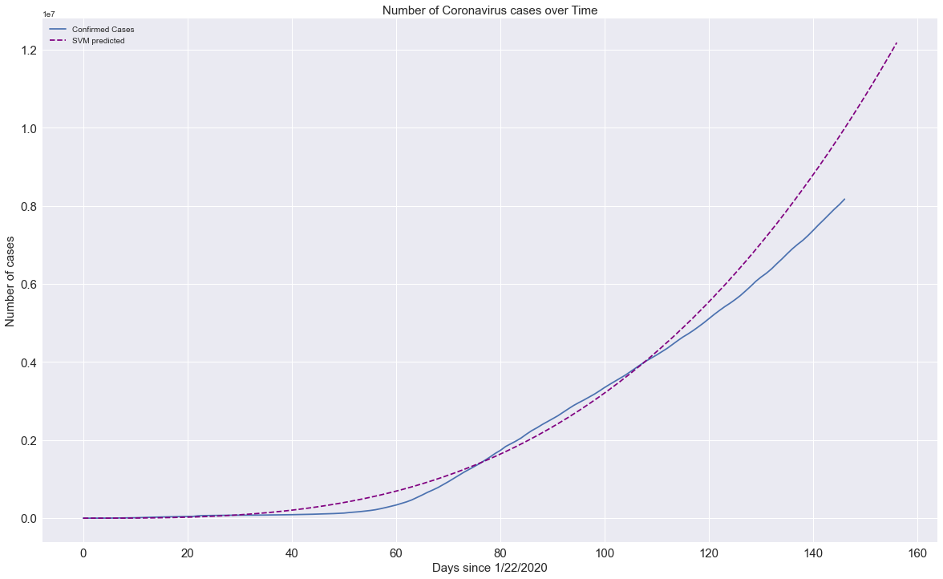
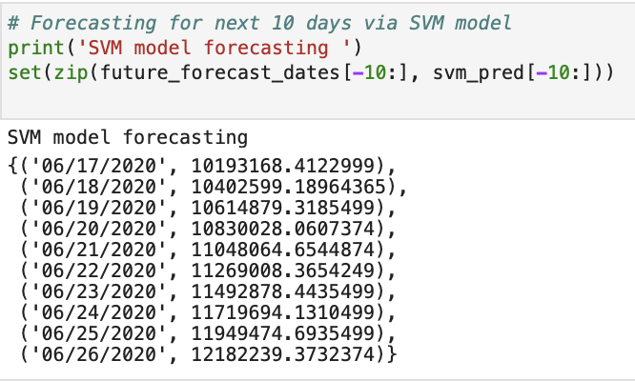
SVM Regression vs confirmed data
Forecasted values for next 10 days on cumulative confirmed cases
via SVM model
Mean Absolute Error: 1163973.2434819655 Mean Squared Error: 1483951323402.676

Slide 16
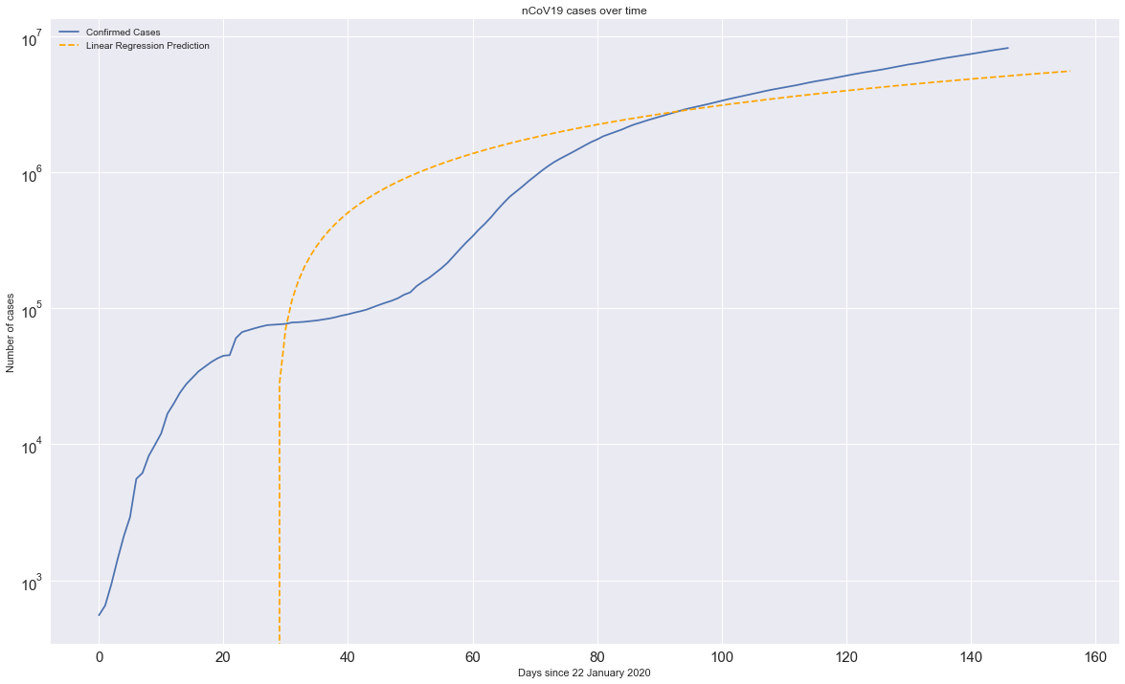
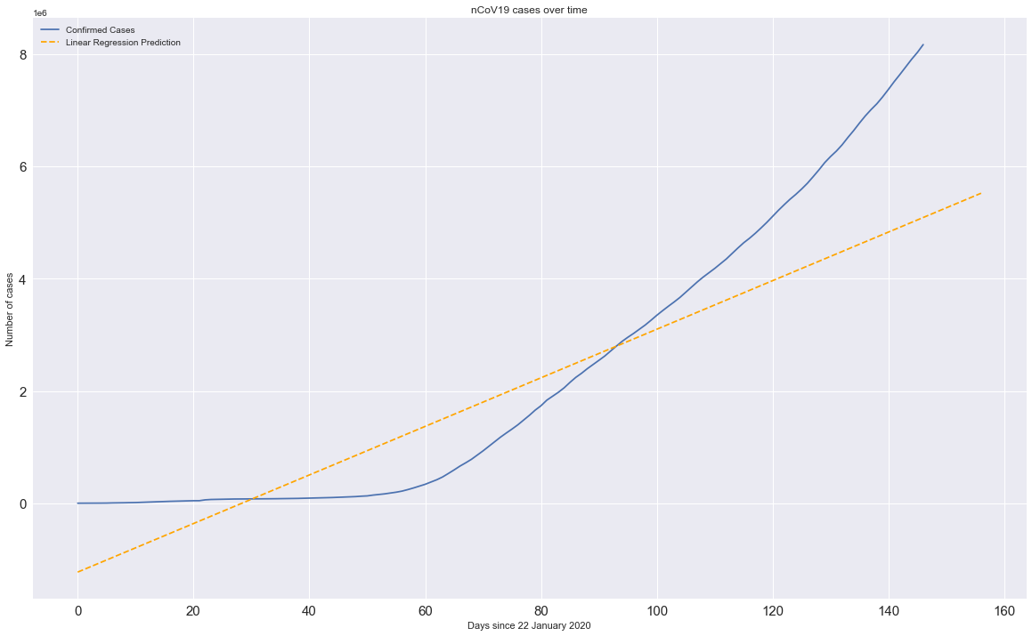
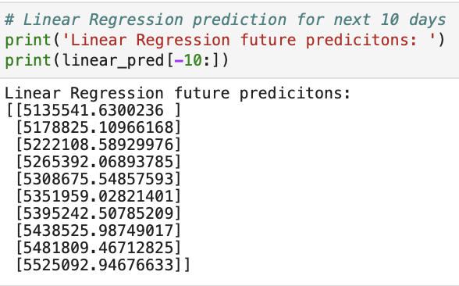
Linear Regression on exponential scale (L.HS.) and
linear scale (R.H.S.)
Forecasted values on new confirmed cases →
Mean Absolute Error: 2172307.3865029244
Mean Squared Error: 4990138414009.445

Slide 17
Conclusions 1. If the R0 remains consistent, its clearly depicted from the prediction models that in near future new cases of COVID-19 will increase. 2. Recently there was a global debate over the use of masks, where the WHO describes its not necessary. But, in my opinion since, prevention is better than cure one must wear mask at all time while in open or in public. 3. It’s recommended that front line workers and people should take shower twice a day within a maximum time gap of 12hr. This will help to maintain sanitization and freshness. 4. Until there is a vaccine or medication against the COVID-19 infection, its recommended to stay indoors and only if necessary, to go out one must always wear personnel protective equipment . Thank You # # # # # #

